Slide 1


Oxy AI: Your Intelligent Health Guardian
A Multi-Agent Framework for Winning the Yodha Hackathon
Team Name: Kernel Ops

Slide 2
The Problem: A Broken Healthcare Ecosystem
Overwhelmed Staff
The "Black Hole" of Support
Hospital resources are strained by repetitive patient queries, diverting precious time from critical care.
Patients lack access to reliable healthcare support outside of traditional office hours, leading to anxiety and delayed care.
Language Barrier
Misinformation Menace
Rural and non-English speaking patients, especially in communities like Malayalam speakers, struggle to navigate complex digital health platforms.
Untrustworthy online sources ("Dr. Google") frequently lead to heightened patient anxiety and potentially harmful self-diagnosis.
Impact: Health equity is broken. We are fixing it.

Slide 3
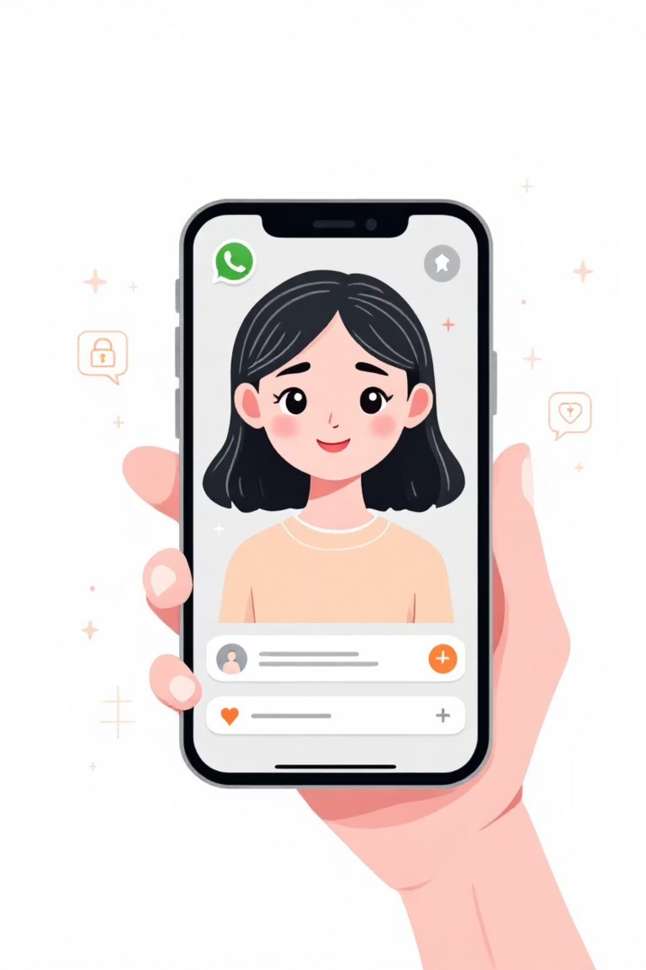



Oxy AI: The 24/7 Multilingual Solution
Our Core Concept: Intelligent, Empathetic Healthcare on WhatsApp
Instant Medical Answers
Hospital-verified information delivered immediately, reducing uncertainty and false alarms.
Appointment & Medication Reminders
Automated scheduling and reminders to ensure patients stay on track with their treatment plans.
Smart Escalation
Critical cases are automatically routed to human doctors, ensuring timely intervention for serious concerns.

Slide 4
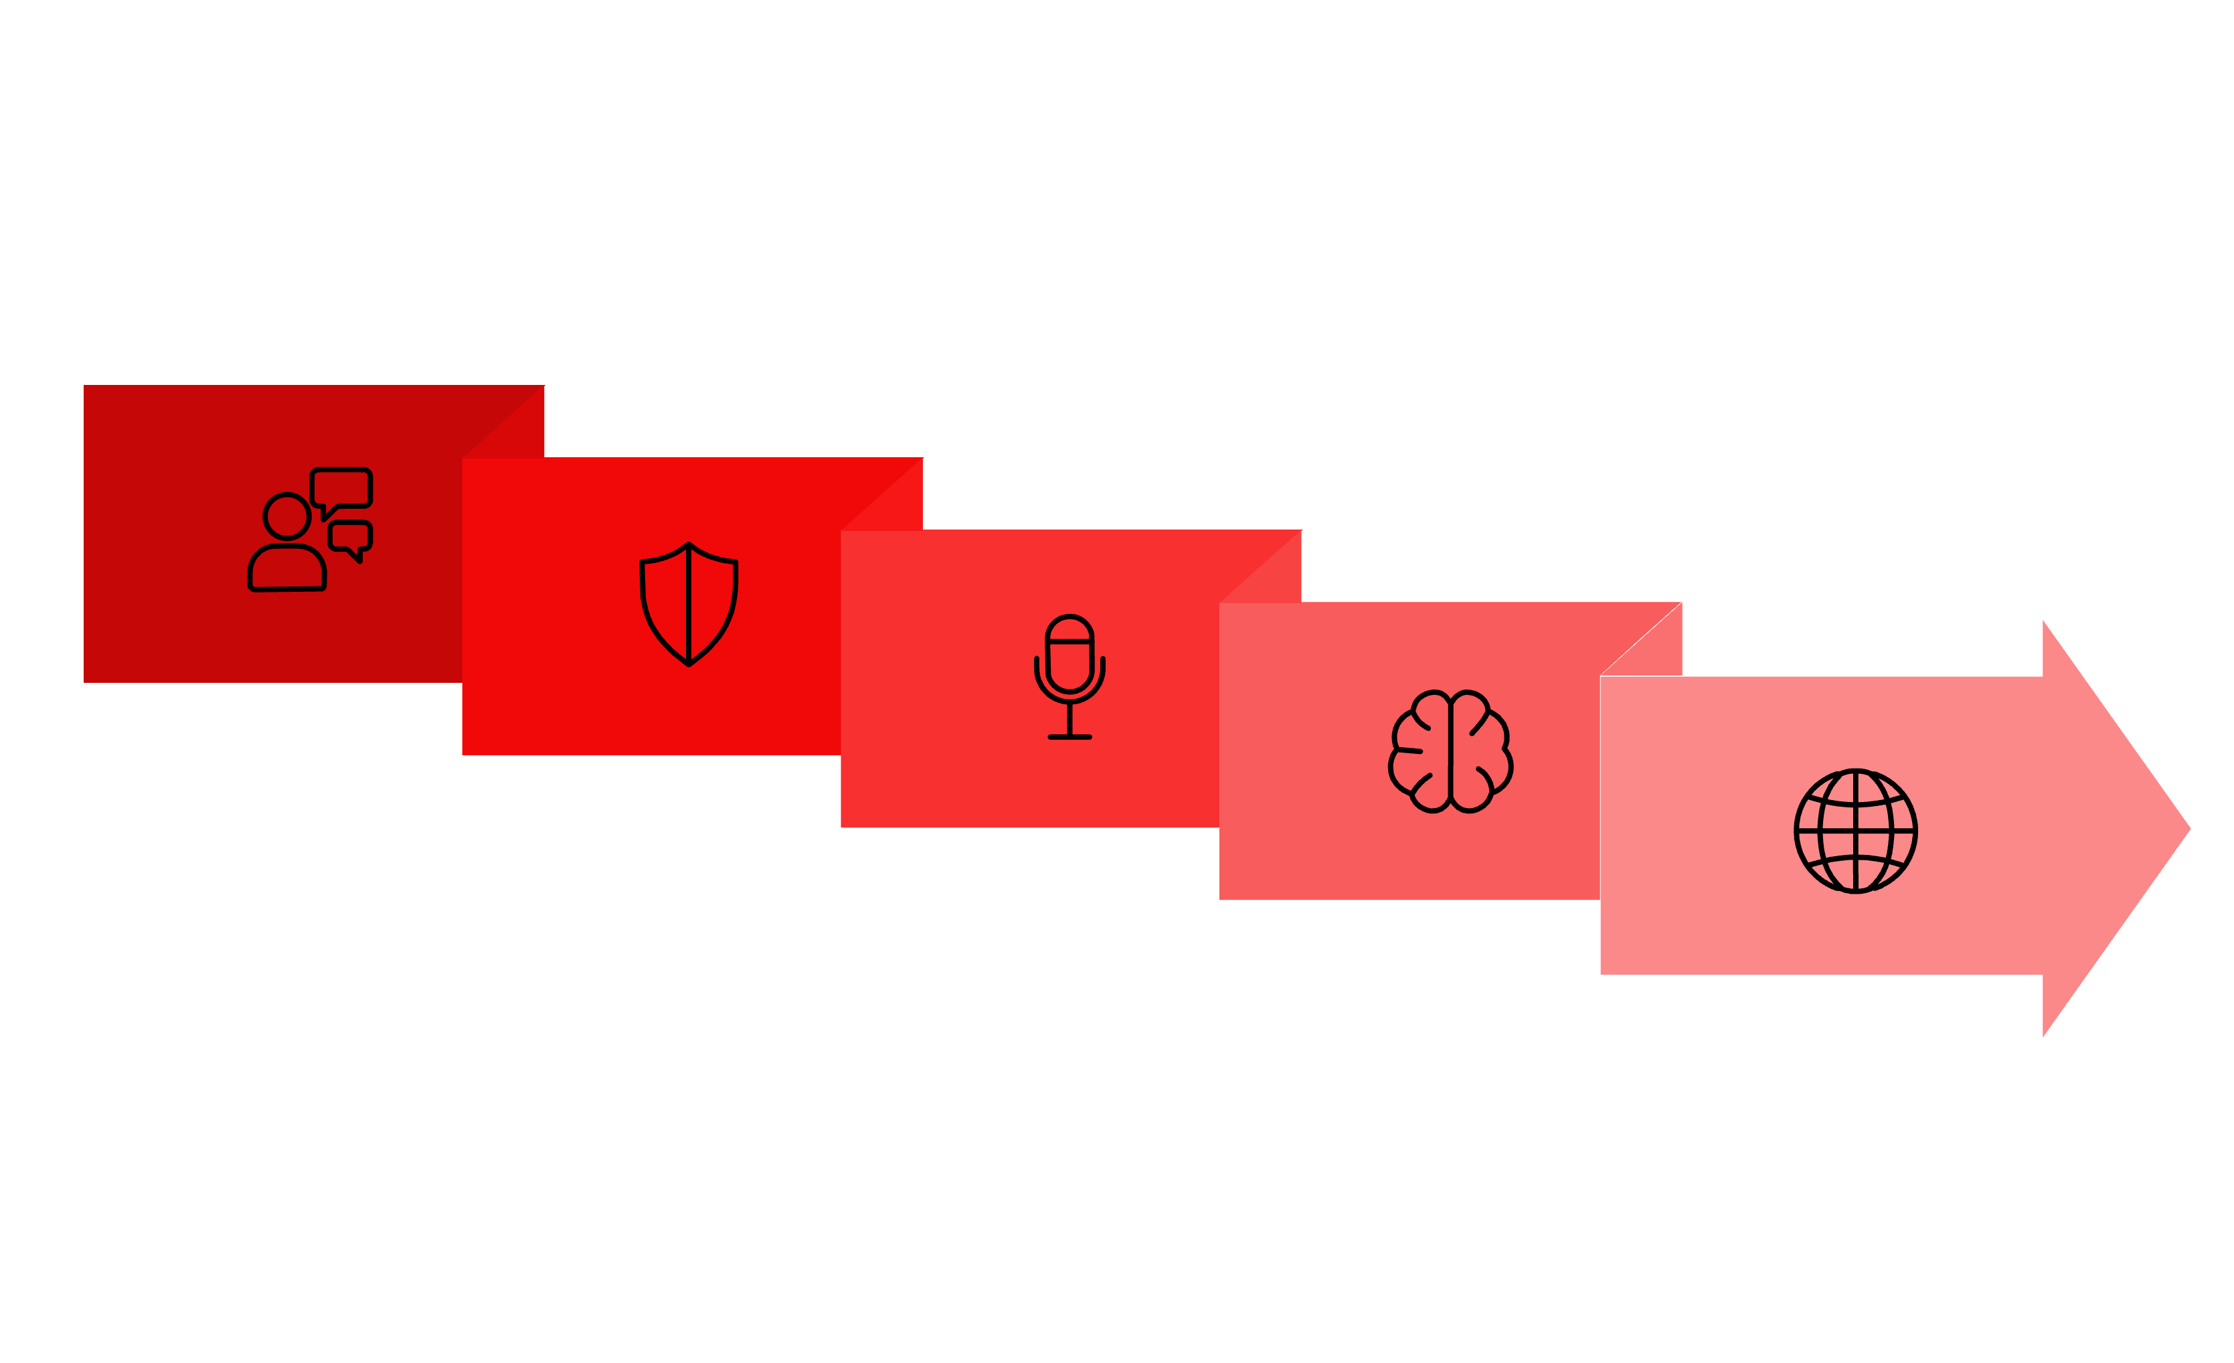





Deep Tech: The Architecture Behind Oxy AI
Ingest
Transcribe
Translate
PII Redact
AI Reasoning

Slide 5




Innovation & Our Unique Value Proposition
Truly Inclusive
Privacy First
Hybrid Model Efficiency
Breaking the literacy barrier with intuitive Voice Notes and local language support, making healthcare accessible to all.
Robust PII Redaction ensures compliance with DPDP Act 2023, protecting sensitive patient data at every step.
Automating 80% of routine queries, freeing human healthcare professionals to focus on the critical 20% that require their expertise.

Slide 6



Social Impact: Empowering Communities
Health Equity for All
Optimized Resource Allocation
Informed Public Health
Eliminating language barriers ensures that elderly and underserved populations receive the healthcare information they deserve.
Aggregated, anonymized data provides valuable insights for data-driven policy decisions and proactive public health initiatives.
Significant reduction in hospital operational costs by automating routine inquiries, allowing staff to focus on patient care.
This aligns with the college's mission of Social Guardianship—technology for the needy.

Slide 7
The Business Case: Scalability & Sustainability
Target Market
Scalability
Oxy AI is designed for immediate integration with hospitals and clinics seeking to modernize patient engagement.
Leveraging existing infrastructure for rapid deployment and expansion.
Large Hospitals: Streamlining operations and improving patient satisfaction.
WhatsApp Business API: Seamless integration with a platform already adopted by millions globally.
Local Clinics: Extending reach and providing 24/7 support without extensive overhead.
Modular Architecture: Easily adaptable to other languages and healthcare systems, enabling swift expansion.
Revenue Model
Fail Fast & Scale: A practical, deployable solution that is ready for real-world impact.
Our clear, sustainable model ensures long-term growth and value for our partners.
SaaS Subscription: Tiered subscription plans for hospitals based on usage and feature access.
Custom Integration: Additional services for tailor-made integrations and advanced analytics.

Slide 8



Oxy AI: Because Healthcare Shouldn't Sleep
Innovation
Cutting-edge AI for real-world healthcare challenges.
Empathy
Human-centric design addressing critical patient needs.
Impact
Measurable improvements in access, efficiency, and equity.

Slide 9



Our Vision: A Future of Equitable Healthcare
Oxy AI is more than just a hackathon project; it's a step towards a future where quality healthcare support is universally accessible, regardless of language, location, or time of day. We believe in technology that serves humanity, and Oxy AI embodies that philosophy.
Join us in building this future, one conversation at a time.

Slide 10

Thank You!
We are confident in Oxy AI's readiness for a pilot program. We invite you to experience firsthand how our solution can transform patient engagement and support.
#OxyAI #KernelOps

